Slide 1
How to export SUMO simulation results
Wushuang Bai

Slide 2
SUMO allows to generate a large number of different measures. Per default, all are disabled, and have to be triggered individually. The purpose of this presentation is to instruct how to export SUMO simulation results using a simple example.
Input:
Network definition file: I99.net.xml
Simulation route definition file: I99.rou.xml
Simulation configuration file: I99.sumocfg
Output:
Floating Car Data (FCD) stored in .csv format, including name, position, angle and type for every vehicle

Slide 3
This tutorial assumes users have already installed SUMO. If not, please install it following this link: https://sumo.dlr.de/docs/Downloads.php

Slide 4
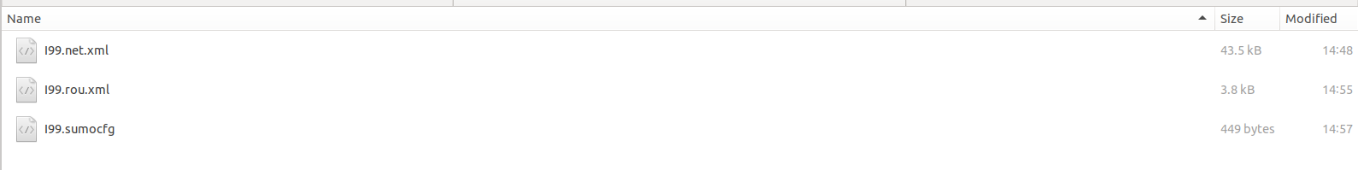
Step 1. Put all input files in one folder.

Slide 5
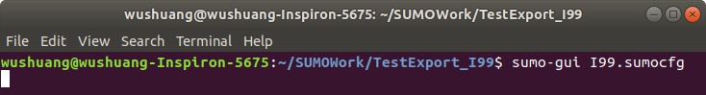
Step 2. Open a terminal in the folder. Make sure you can run the simulation, by running "sumo-gui I99.sumocfg" command

Slide 6
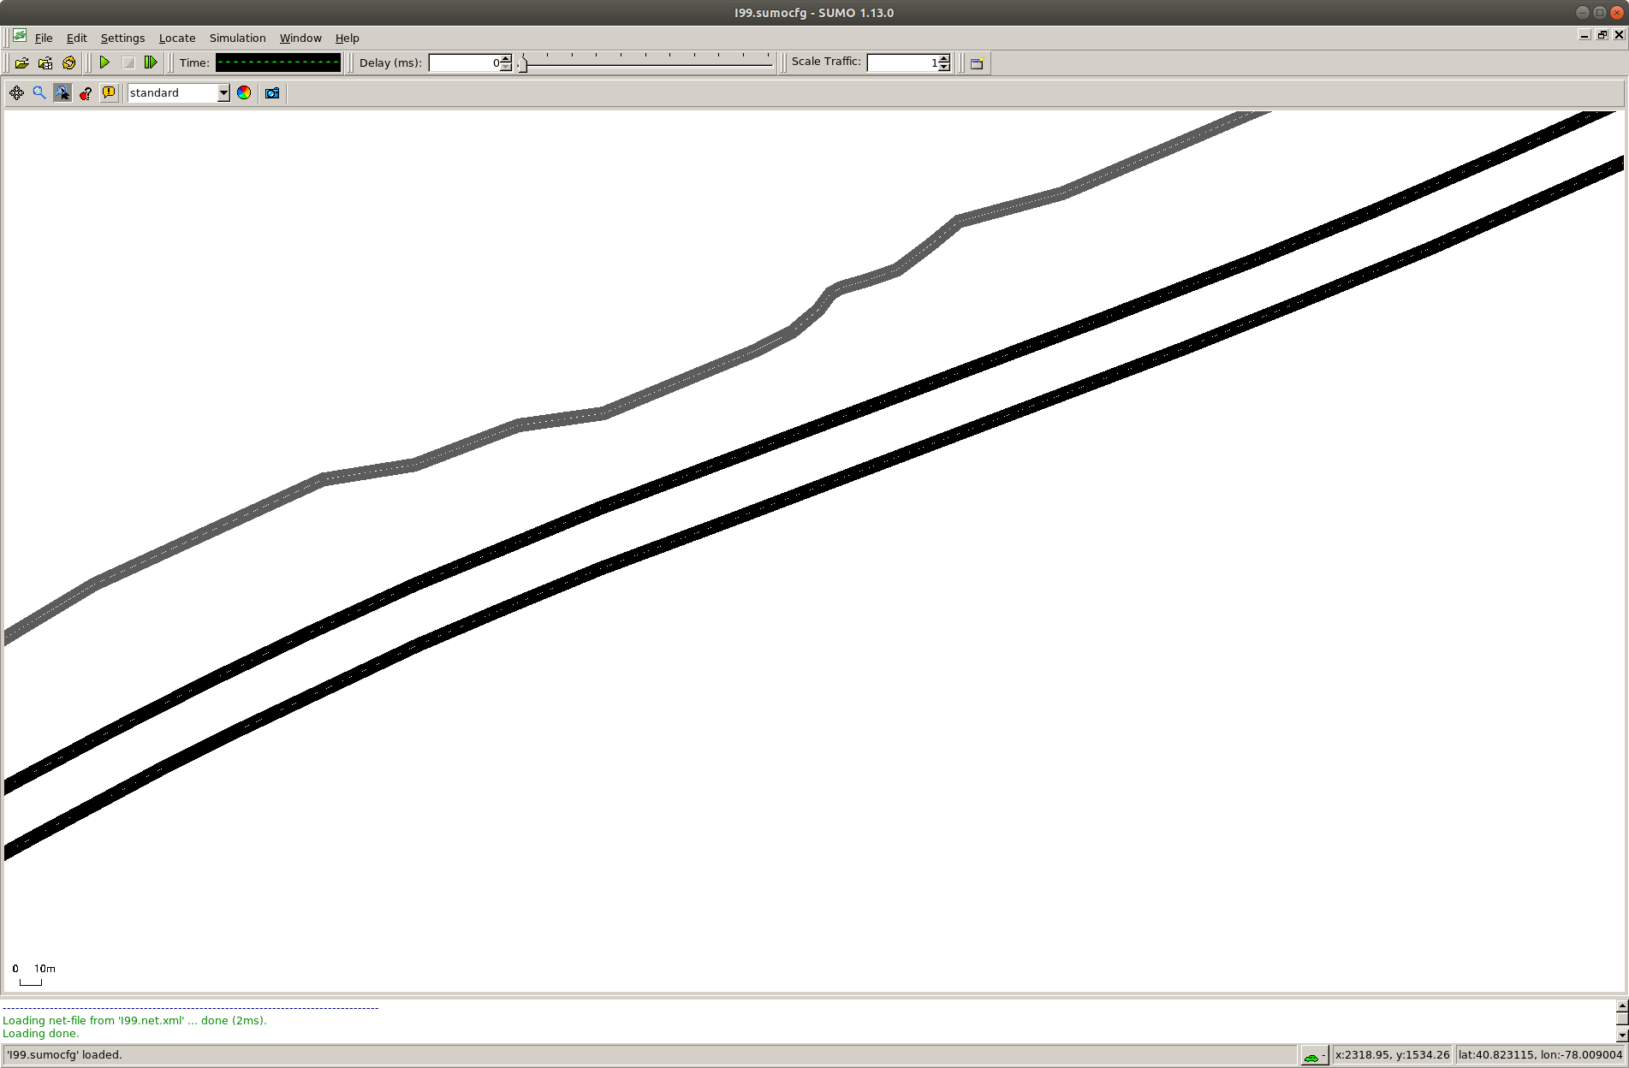
Step 3. A sumo simulation window should pop up after running the command.

Slide 7
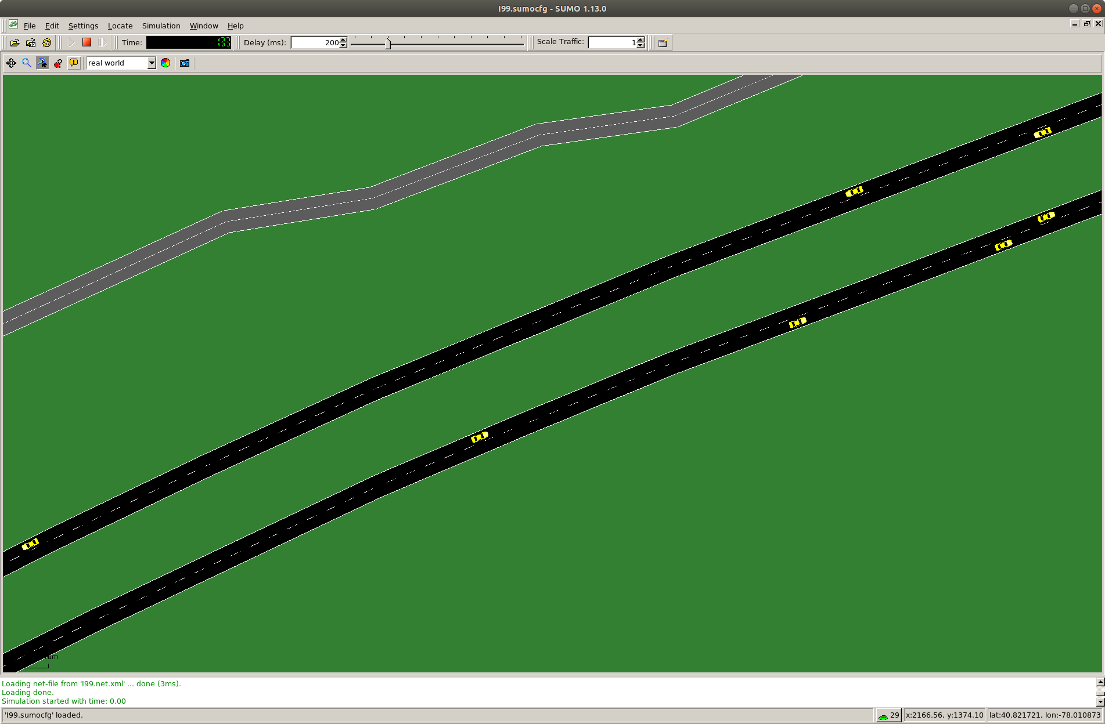
Step 4. change the simulation from standard to real world, add 100ms delay to allow visualizing the simulation. Click on play button. The simulation starts to play.

Slide 8
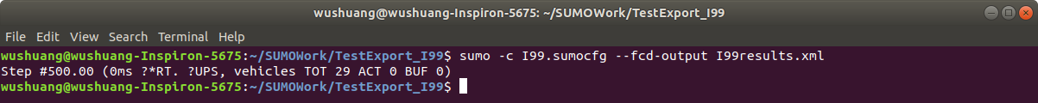
Step 5. The above steps verify that the input files are working. Now run command "sumo –c I99.sumocfg --fcd-output I99results.xml"
The command is explained as below:
Sumo –c CONFIGURATION_FILE: start with a sumo configuration file
--fcd-output OUTPUTFILE: save Float Car Data output

Slide 9
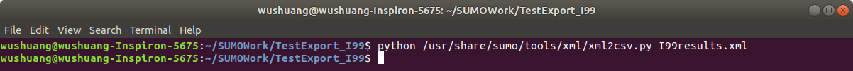
Step 6. Run command "python /path_to_sumo/tools/xml/xml2csv.py I99results.xml" to convert the simulation results from xml to csv.

Slide 10
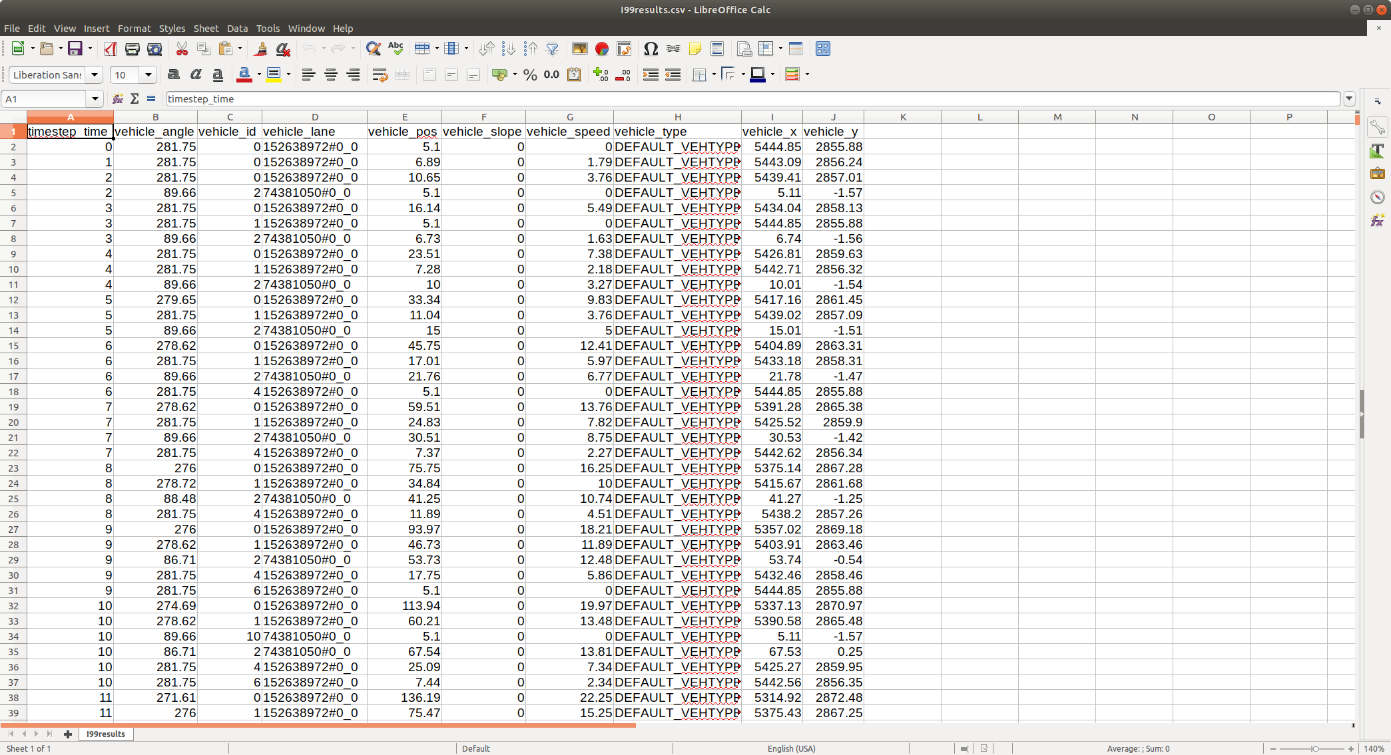
Step 7. Simulation results have been exported in .csv format.

Slide 11
Files used in this tutorial can be found below:
Input files and simulation results can be found at:
https://pennstateoffice365.sharepoint.com/:f:/r/sites/IntelligentVehiclesandSystemsGroup-Active/Shared%20Documents/IVSG/Projects/Active/2021-2024_PennDOT_ADS_ConstructionZones/12_SUMO_Simulation_Pretesting/Testing_Data/how%20to%20export%20SUMO%20simulation%20results?csf=1&web=1&e=TUClz8

Slide 12
For more information, please see: https://sumo.dlr.de/docs/Simulation/Output/index.html

